Slide 1
Web Services tools installation
PRESENTED TO Mobile app team
Date : 20th July 2016

Slide 2
Web Services Tools Installation
Contents
Installing Apache Tomcat in Mac
Installing MySql in Mac
Installing MySql Workbench in Mac
Installing Eclipse in Mac
Installing SoapUI for testing Web Services
Soap UI installation problems
2

Slide 3
Installing Apache Tomcat in Mac
Here are the easy to follow steps to get it up and running on your Mac
Download a binary distribution of the core module : apache-tomcat-8.5.3.tar.gz from here. I picked the tar.gz in Binary Distributions / Core section.
Opening/unarchiving the archive will create a folder structure in your Downloads folder: (btw, this free Unarchiver app is perfect for all kinds of compressed files and superior to the built-in Archive Utility.app
~/Downloads/apache-tomcat-8.5.3
2

Slide 4
Installing Apache Tomcat in Mac
Open to Terminal app to move the unarchived distribution to /usr/local
sudo mkdir -p /usr/local
sudo mv ~/Downloads/apache-tomcat-8.5.3 /usr/local
To make it easy to replace this release with future releases, we are going to create a symbolic link that we are going to use when referring to Tomcat (after removing the old link, you might have from installing a previous version):
sudo rm -f /Library/Tomcat
sudo ln -s /usr/local/apache-tomcat-8.5.3 /Library/Tomcat
Change ownership of the /Library/Tomcat folder hierarchy:
sudo chown -R <your_username> /Library/Tomcat
Make all scripts executable:
sudo chmod +x /Library/Tomcat/bin/*.sh
2

Slide 5
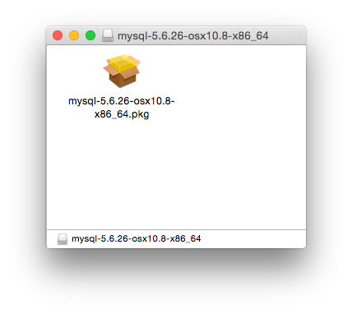
Installing MySQL in Mac
To install MySQL using the package installer:
Download the disk image (.dmg) file (the community version is available at http://dev.mysql.com/downloads/mysql/) that contains the MySQL package installer. Double-click the file to mount the disk image and see its contents.
Fig 1.0 : Package Installer: DMG Contents
2

Slide 6
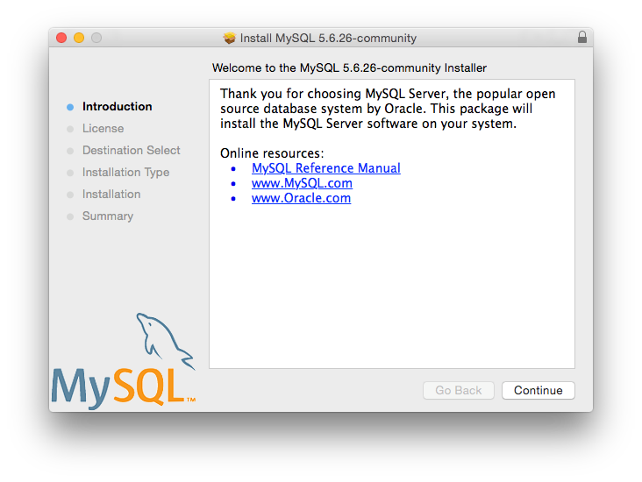
Installing MySQL in Mac
Double-click the MySQL installer package. It will be named according to the version of MySQL you have downloaded. For example, if you have downloaded MySQL server 5.7.16, double-click mysql-5.7.16-osx-10.11-x86_64.pkg.
You will be presented with the opening installer dialog. Click Continue to begin installation.
Fig 1.1 : MySql Package Installer : Introduction
2

Slide 7
Installing MySQL in Mac
If you have downloaded the community version of MySQL, you will be shown a copy of the relevant GNU General Public License. Click Continue and then Agree to continue.
From the Installation Type page you can either click Install to execute the installation wizard using all defaults, click Customise to alter which components to install (MySQL server, Preference Pane, Launchd Support -- all enabled by default), or click Change Installation Location to change the type of installation, if available.
2

Slide 8
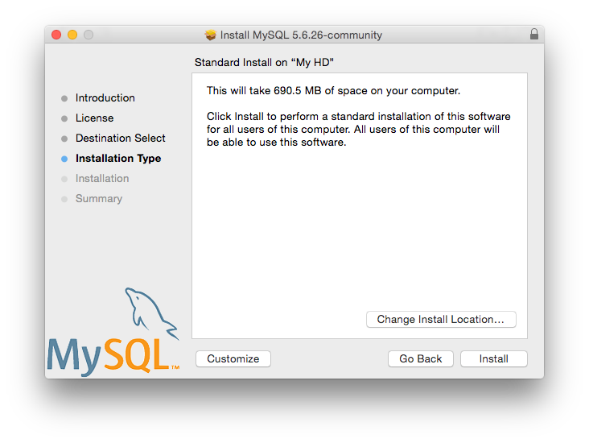
Installing MySQL in Mac
Fig 1.2 : MySql Package Installer : Installer Type
2

Slide 9
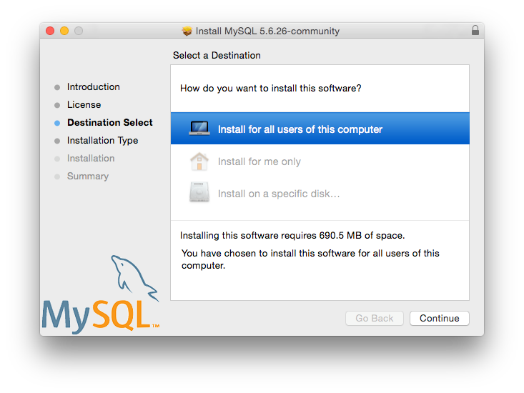
Installing MySQL in Mac
Fig 1.3 : MySql Package Installer : Mac Installer Destination
2

Slide 10
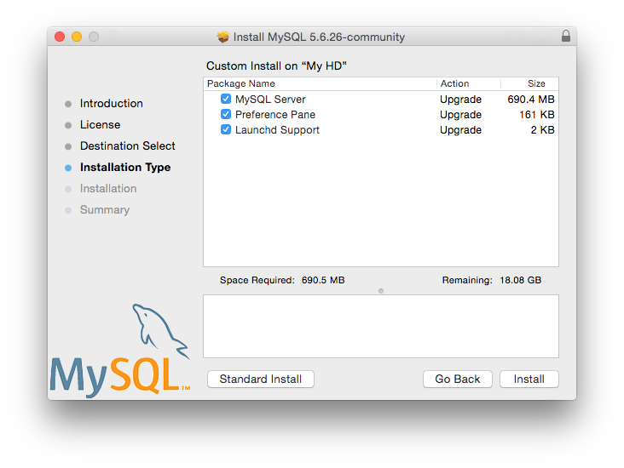
Installing MySQL in Mac
Fig 1.4 : MySql Package Installer : Mac Installer Installation Type
2

Slide 11
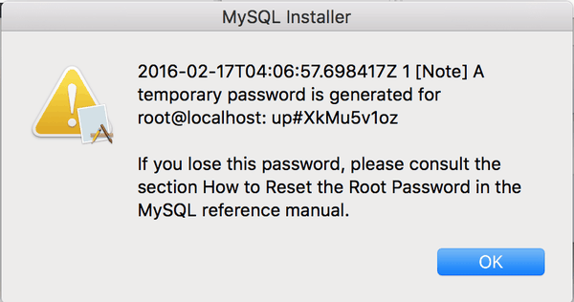
Installing MySQL in Mac
Click Install to begin the installation process.
Once the installation has been completed successfully, you will be provided with your temporary root password. This cannot be recovered, so you must save this password. For example:
Fig 1.5 : MySQL Package Installer: Temporary Root Password
2

Slide 12
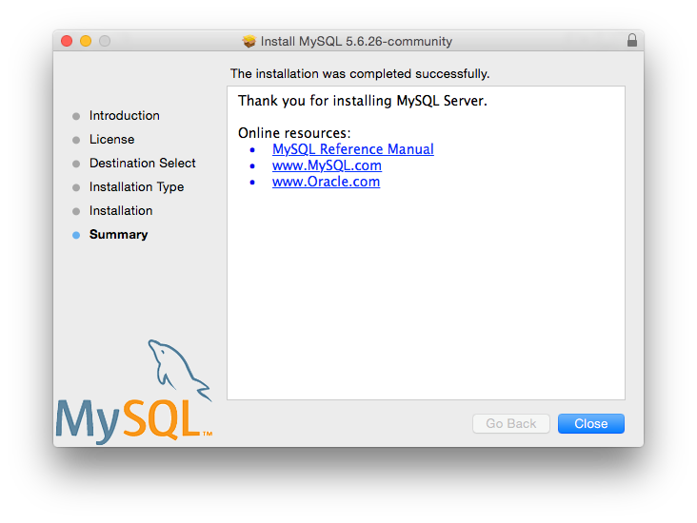
Installing MySQL in Mac
Next is an Install Succeeded message with a short summary. Close the wizard.
Fig 1.6 : MySQL Package Installer: Summary
2

Slide 13
Installing MySQL in Mac
MySQL server is now installed, but it is not loaded (or started) by default. Use either launchctl from the command line, or start MySQL by clicking "Start" using the MySQL preference pane. For additional information, see https://dev.mysql.com/doc/refman/5.7/en/osx-installation-launchd.html, and https://dev.mysql.com/doc/refman/5.7/en/osx-installation-prefpane.html.
Use the MySQL Preference Pane or launchd to configure MySQL to automatically start at bootup.
2

Slide 14
Installing MySQL in Mac
Directory | Contents of Directory
bin, scripts | mysqld server, client and utility programs
data | Log files, databases
docs | Helper documents, like the Release Notes and build information
include | Include (header) files
lib | Libraries
man | Unix manual pages
mysql-test | MySQL test suite
share | Miscellaneous support files, including error messages, sample configuration files, SQL for database installation
support-files | Scripts and sample configuration files
/tmp/mysql.sock | Location of the MySQL Unix socket
Table 1.0 : MySQL Installation Layout on OS X
During the package installer process, a symbolic link from /usr/local/mysql to the version/platform specific directory created during installation will be created automatically.
2

Slide 15
Installing MySql Workbench in Mac
MySQL Workbench for OS X is distributed as a DMG file. The file is named mysql-workbench-community-version-osx.dmg, where version is the MySQL Workbench version.
Downloads are available at http://dev.mysql.com/downloads/workbench/.
To install MySQL Workbench on OS X, download the file. Double-click the downloaded file. You will be presented with the installation window.
2

Slide 16
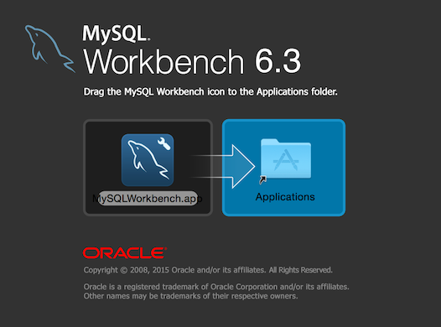
Installing MySql Workbench in Mac
Drag the MySQL Workbench icon onto the Applications icon as instructed. MySQL Workbench is now installed.
You can now launch MySQL Workbench from the Applications folder, or from the command line:
Fig 1.7 : MySQL Workbench OS X Installation Window
shell> /Applications/MySQLWorkbench.app/Contents/MacOS/MySQLWorkbench --help
2

Slide 17
Installing Eclipse in Mac
Go to http://www.eclipse.org/downloads/ to download a copy of eclipse
After downloading, the download will go to your Downloads folder. You will normally have an icon for the Downloads folder on the right-hand side of the dock. Find eclipse-java-helios-SR2-macosx-cocoa.tar.gz in your Downloads folder, and drag it to the Desktop. Then double-click it. You will see a folder named "eclipse."
Drag the "eclipse" folder into your Applications folder. The easiest way to do so is to open a new window in the Finder and click on Applications in the list you get on the left-hand side. Then drag the "eclipse" folder in with the other applications. Make sure that you do not drag it into a folder that's already within Applications. In other words, when you're done, the Applications folder should have directly within it a folder named "eclipse."
2

Slide 18
Installing Eclipse in Mac
(This step is not required, but it's strongly recommended.) Double click the "eclipse" folder. You'll see an application named "Eclipse"; it has a purple icon with white horizontal stripes. Drag it into your dock. Now you will be able to launch Eclipse by clicking on the icon in the dock.
You may now drag eclipse-java-helios-SR2-macosx-cocoa.tar.gz to the Trash. Empty the Trash whenever you wish.
When you launch Eclipse for the first time, you'll be asked "'Eclipse' is an application downloaded from the Internet. Are you sure you want to open it?" Click "Open."
2

Slide 19
Installing SoapUI for testing Web Services
Once you've downloaded the installer from the following link : https://www.soapui.org/downloads/soapui.html, the installation is pretty strait forward. Start it by just double-clicking on it. After preparing the installation which takes only a few seconds you'll see the starting screen
Just click Next to continue. You'll be asked to accept our license agreement
After accepting and clicking Next you'll be able to select the destination folder which by default is set to /Applications but can be changed
Next step gives you opportunity to optionally include, as additional components, SoapUI source files and Hermes installation.
2

Slide 20
Installing SoapUI for testing Web Services
In case of installing SoapUI Pro JDBC drivers jars can be included as additional option (and of course no source is available).
After that a window appears where you'll be asked to select if desktop icon should be created and if jxbrowser should be disabled. Starting from version SoapUI 3.6-beta2 JxBrowser is working on mac, but there is still a issue left with browser being always displayed on top if opened.
Finally, by clicking Next, the installation starts
After couple of minutes most the installation should be finished and you should see the next screen
Now you are ready to use it after pressing “Finish”. Good luck!
2

Slide 21
Soap UI installation problems
If your installed SoapUI instance on a Mac is not responding, try the following steps to resolve the issue: In soapui-settings.xml file add or update the following line: <con:setting id="UISettings@disable-browser">true</con:setting>
If that doesn't work, start SoapUI Pro with the following parameter added to the command line: -Dsoapui.jxbrowser.disable=true
Alternatively, you can navigate to SoapUI*.app and do "Show Package Info" ( from popup menu ). Then you should see Contents directory. Open Info.plist file for editing where you can add: <key>soapui.jxbrowser.disable</key><string>true</string>
2

Slide 22
Soap UI installation problems
We have also seen some issues with SoapUI installs in Mac when GateKeeper is active. So to rule out that possible conflict, deactivate GateKeeper and try starting SoapUI
Also if you want to change the look and feel of SoapUI or SoapUI Pro to look more like a Mac application, change the following settings:
Go to File > Preferences > UI Settings tab
Check "Use native look & feel"
Restart SoapUI Pro
2

Slide 23
Thank you
For more details, please contact:
Rohit Saraf
Software Engineer
Email:rsaraf@easi.com

